Slide 1
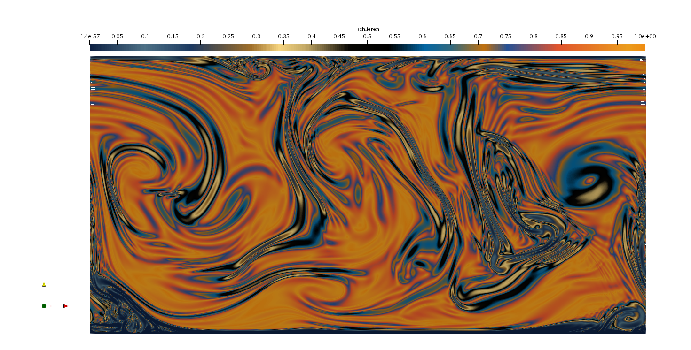
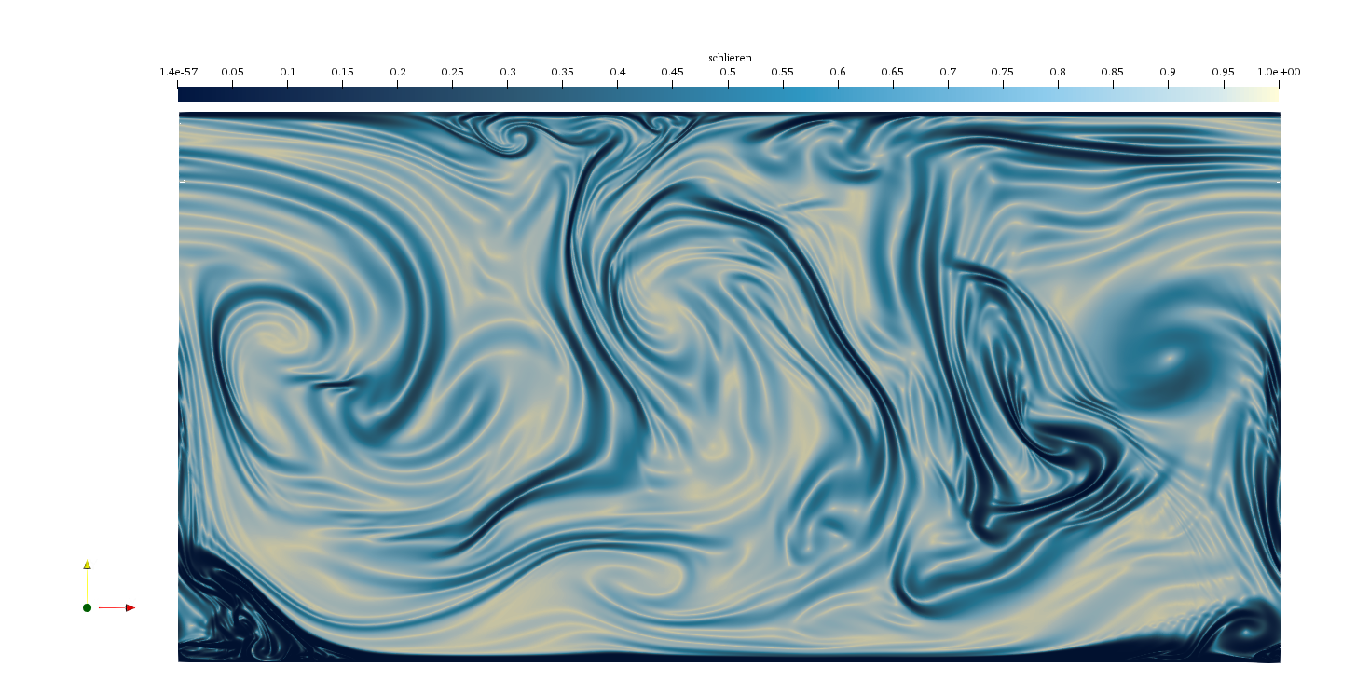
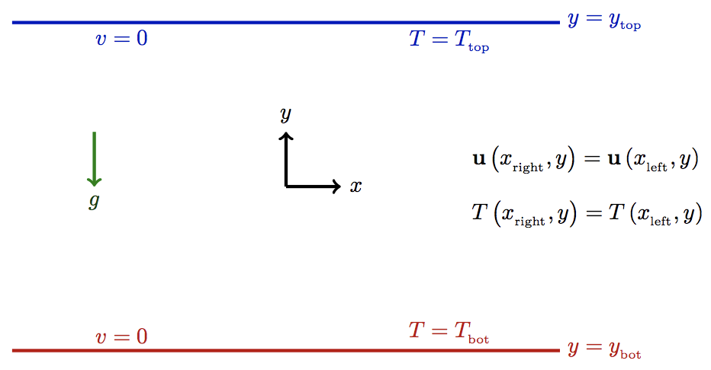
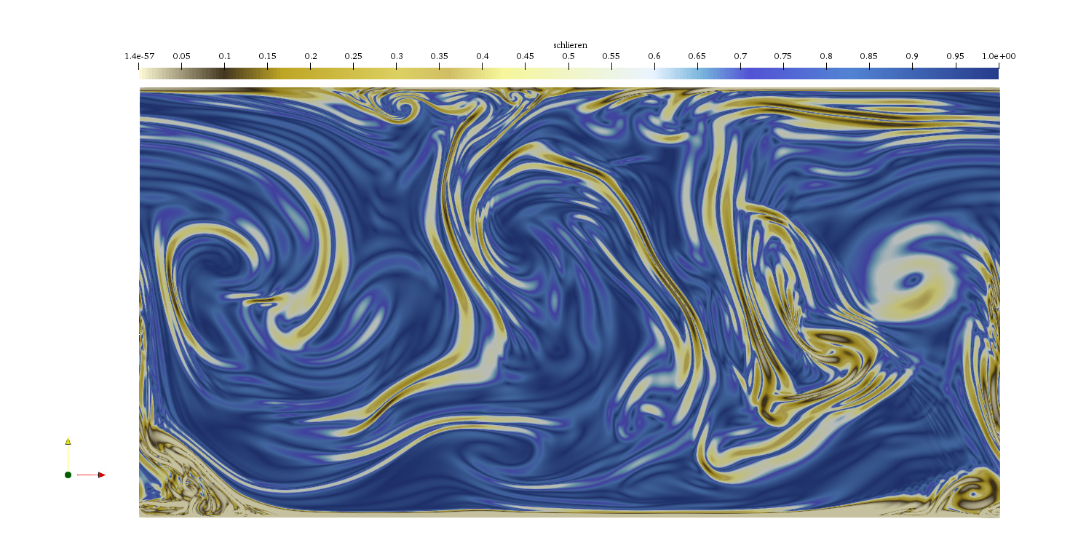
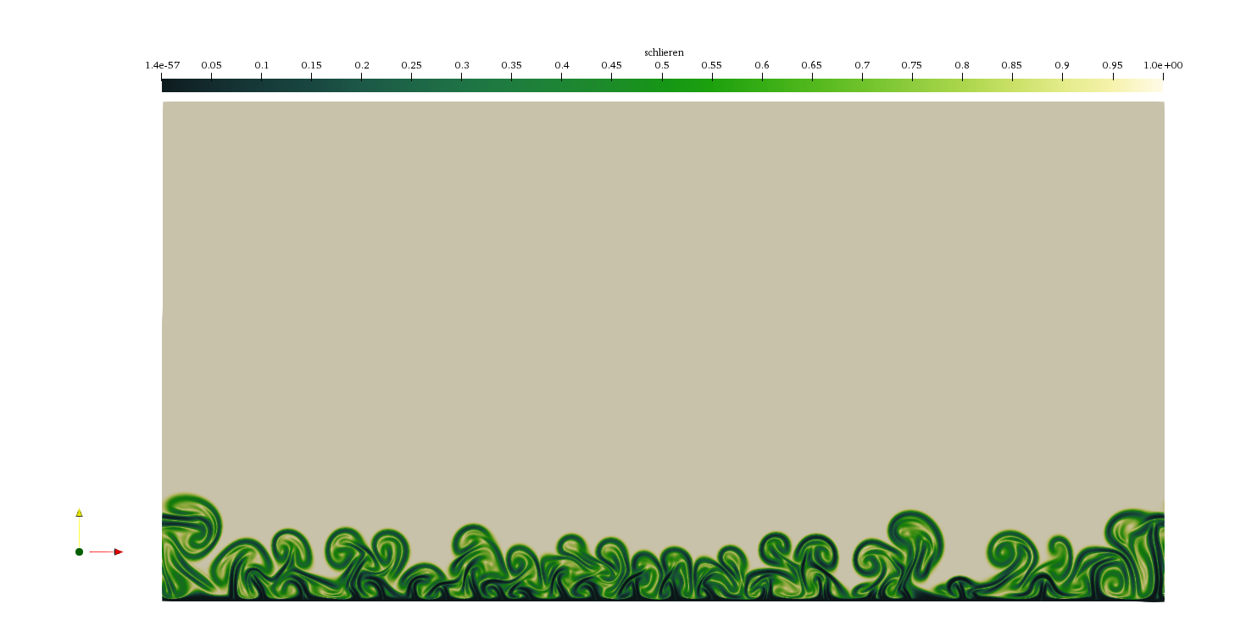
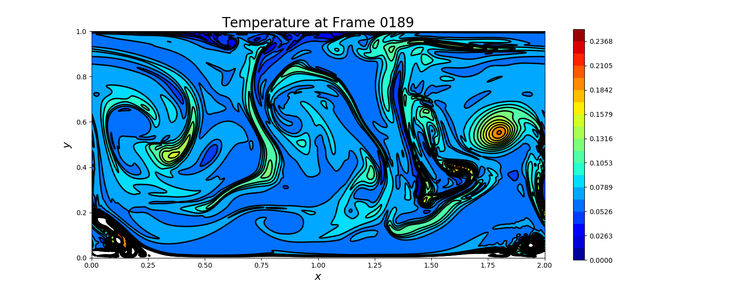
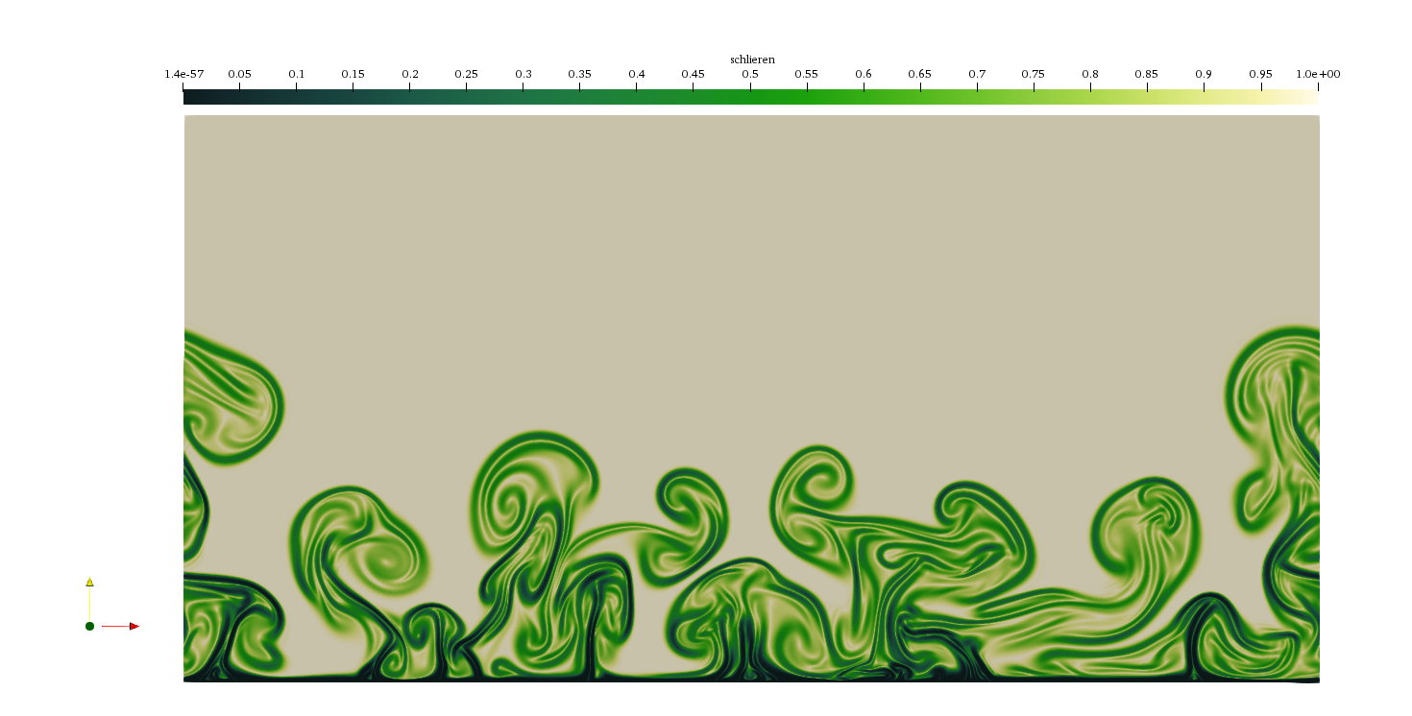
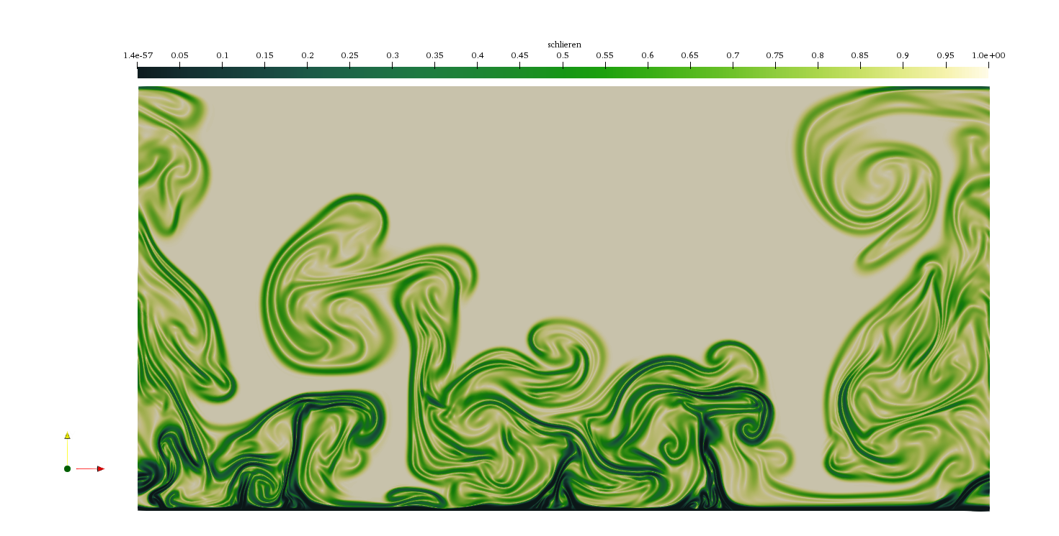
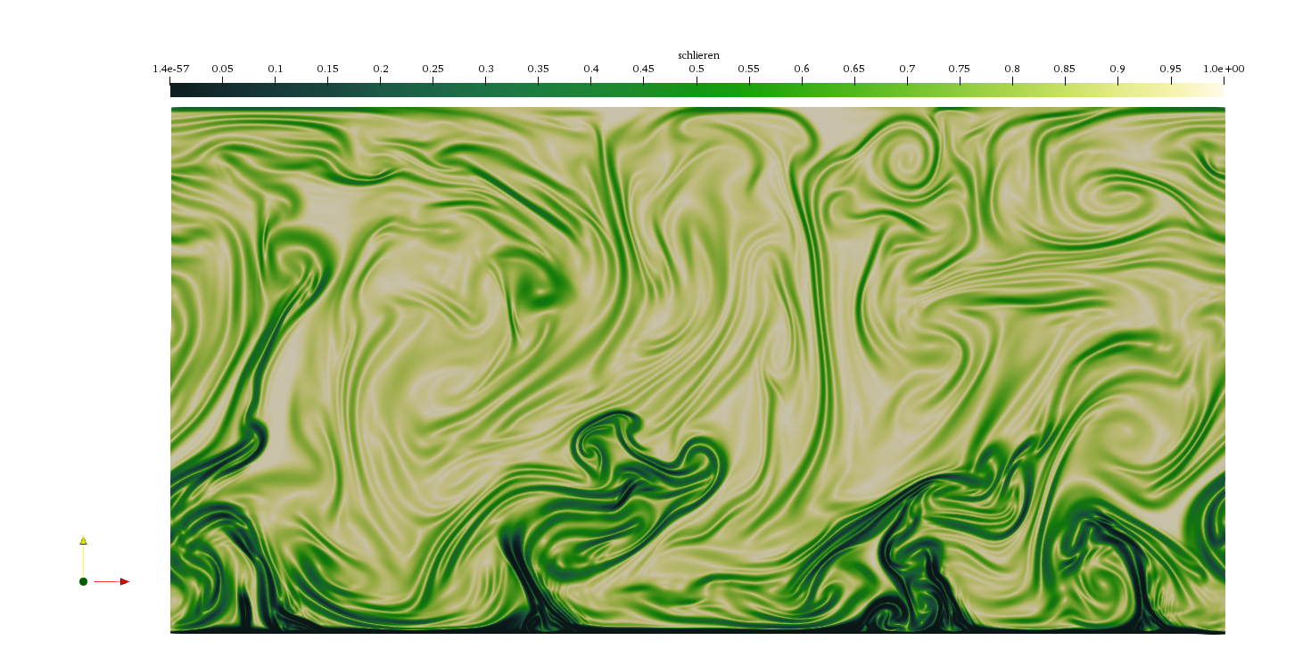
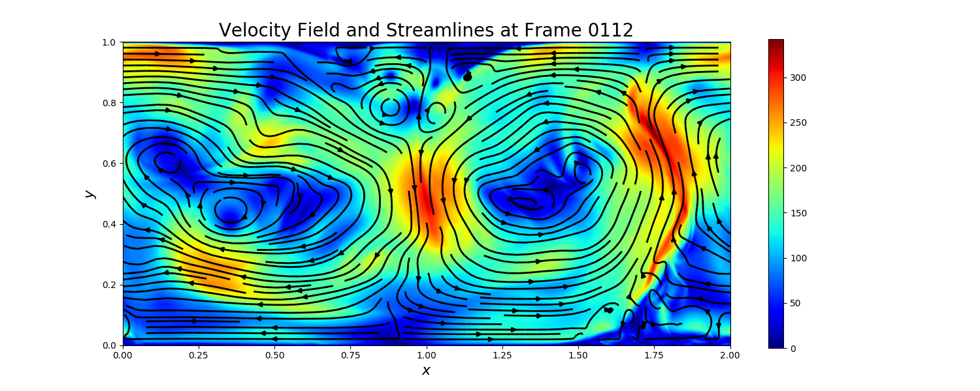
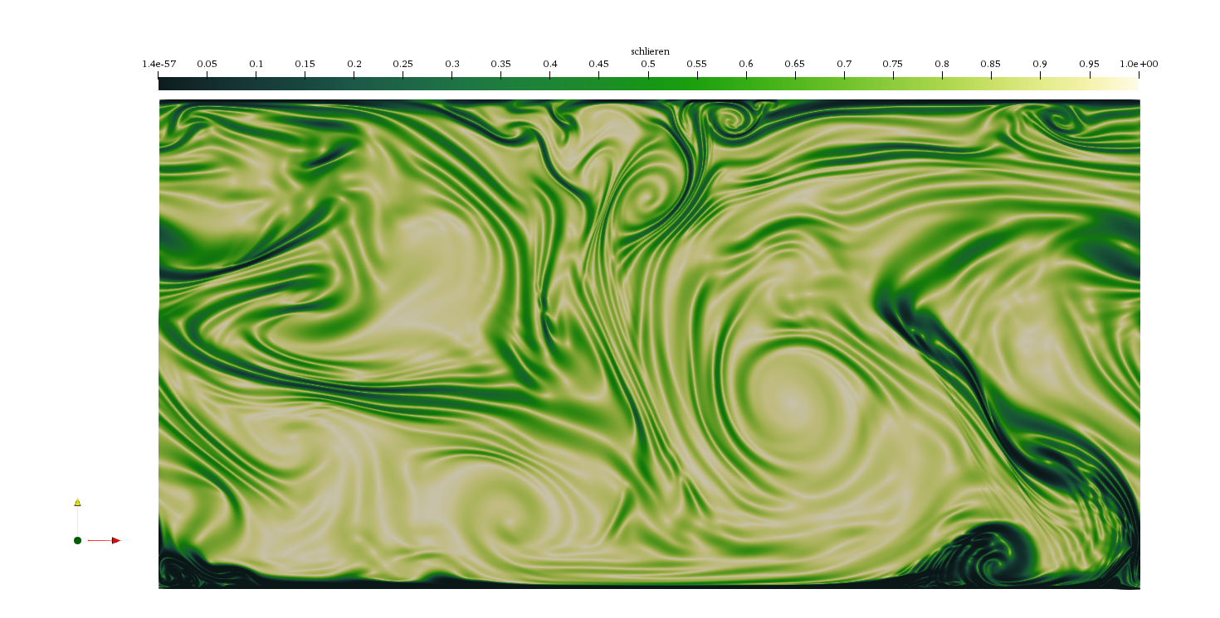
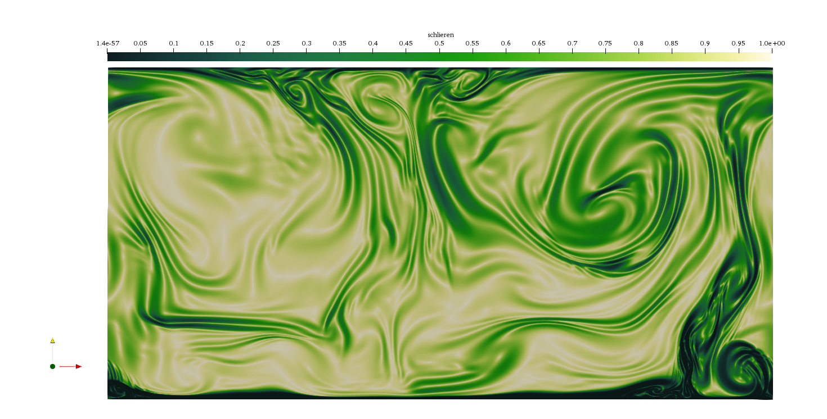
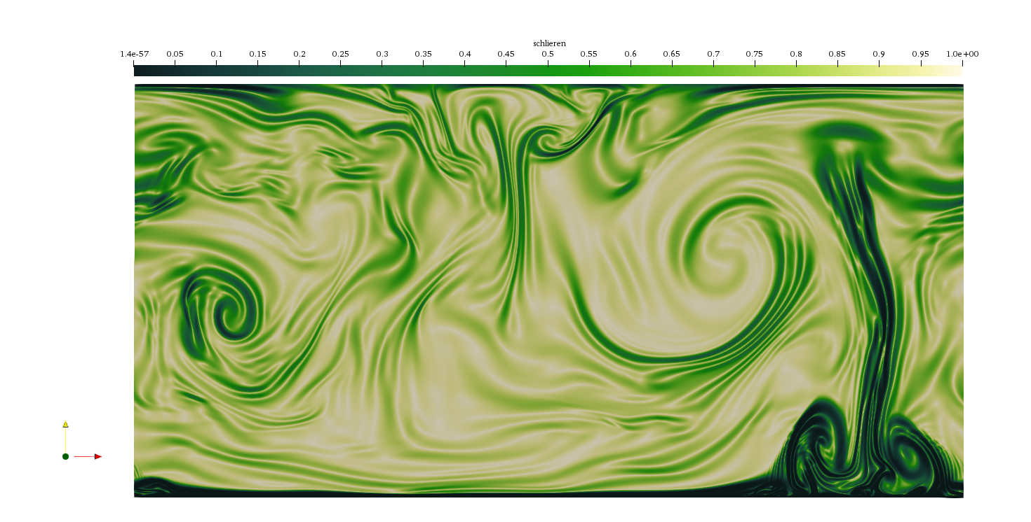
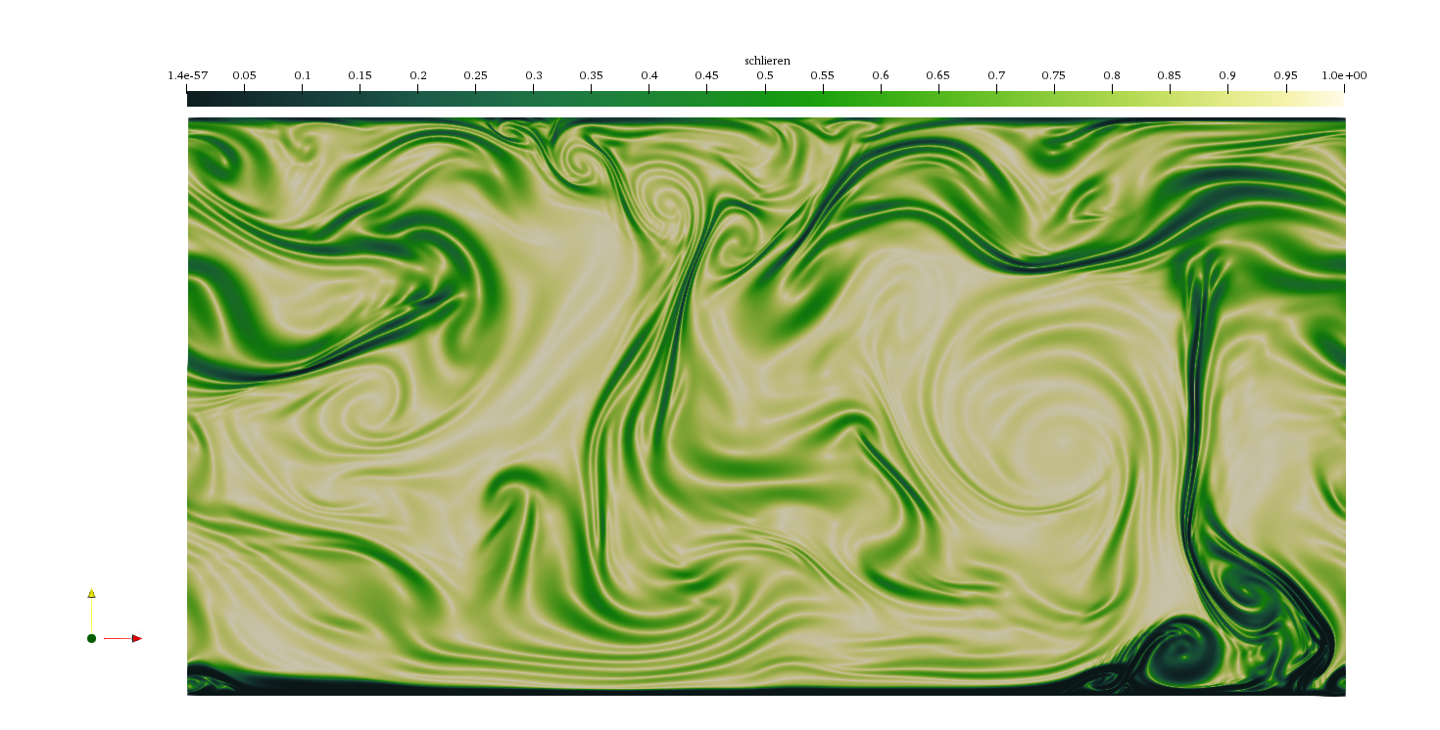
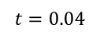
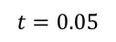
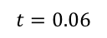
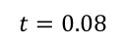
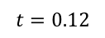
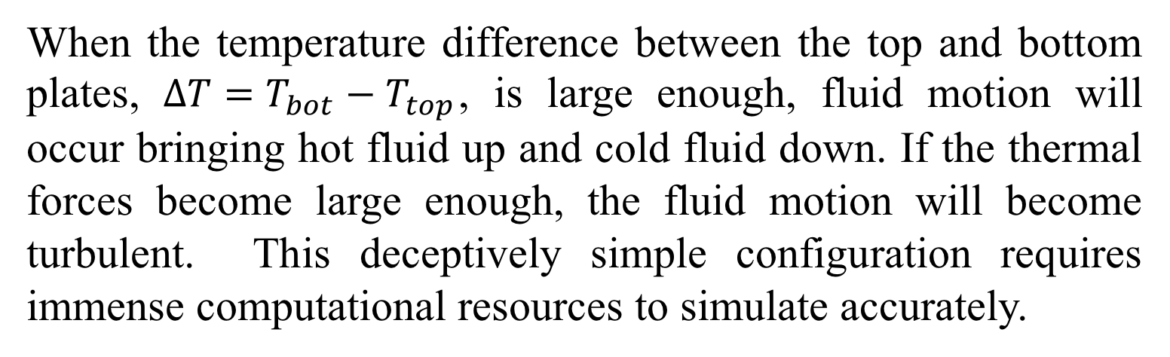
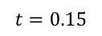
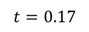
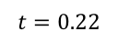
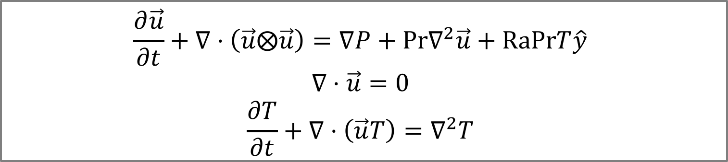
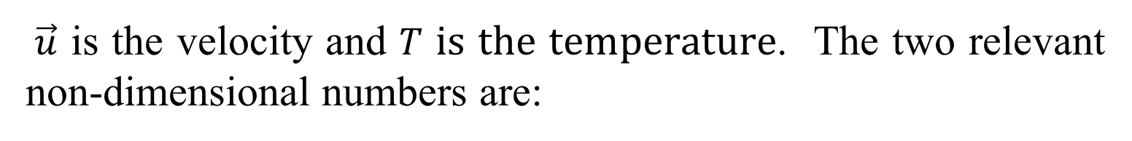
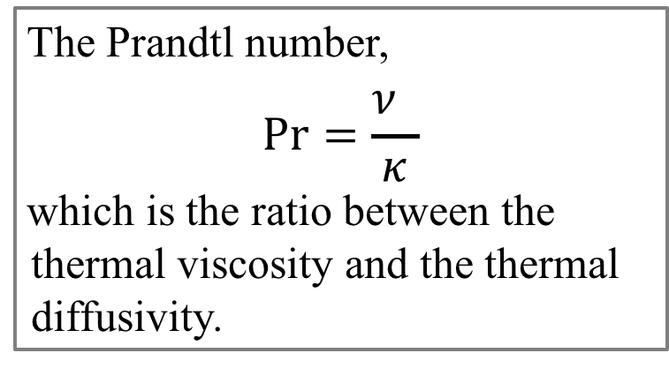
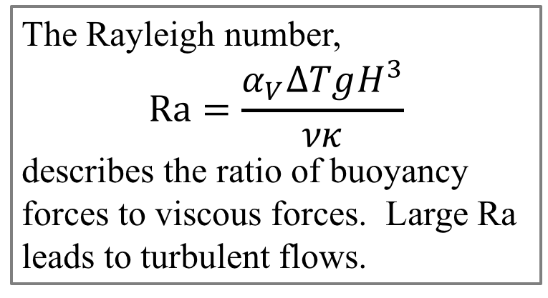
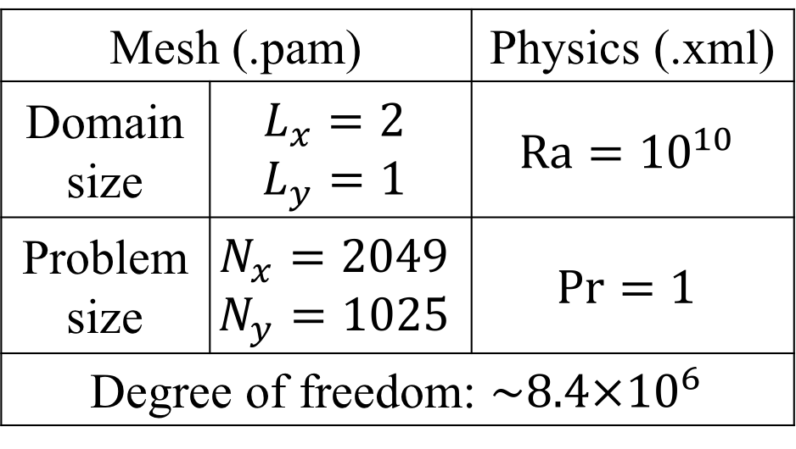
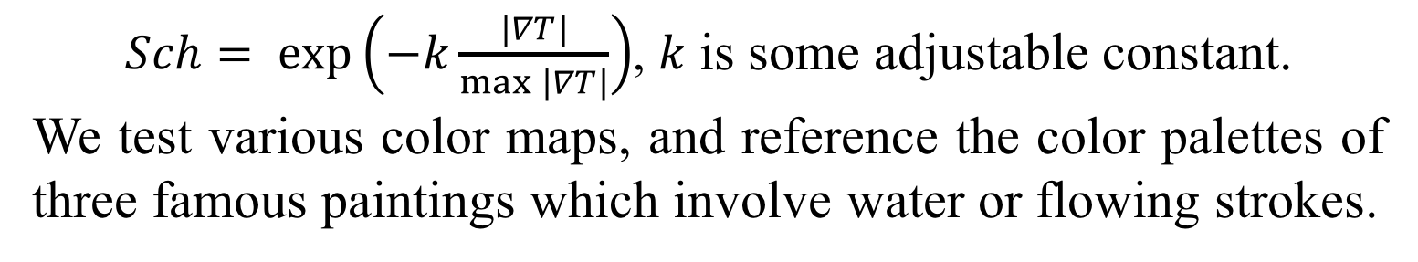
Numerical Simulation of Rayleigh–Bénard Convection Yue Sun¹, Michael S. Emanuel¹, Jonathan Guillotte-Blouin¹ ¹Harvard University School of Engineering and Applied Sciences
Spring 2019 AC290r: Extreme Computing: Project-based High Performance Distributed and Parallel Systems
ABSTRACT
APPROACH
We present a large-scale numerical simulation of a two dimensional turbulent Rayleigh-Bénard convection using the Drekar code, a parallelized finite element fluid solver from Sandia National Labs, on Harvard’s Odyssey supercomputing cluster. We postprocess the parallel outputs and visualize the temperature and velocity fields, all exhibiting the turbulent motion of the flow. We also implement Schlieren flow visualization as a bridge between painting and fluid dynamics.
DREKAR: CODE DESCRIPTION
ODYSSEY: PLATFORM DESCRIPTION
Massively parallel fluid simulation code (C++)
Finite element methods
Linear/nonlinear solvers, preconditioners, eigenvalue solvers, time integrators and automatic differentiation
Developed at Sandia National Laboratories
Supports compressible fluids, incompressible fluids, low-mach compressible fluids, compressible and incompressible magnetohydrodynamics, and multi-species plasmas
Harvard’s largest supercomputing cluster
2,000+ nodes, 78,000+ CPU cores, 1M+ CUDA cores
35PB+ storage, 250TB+ RAM
Supported by FASRC
Core operating system is CentOS
Utilizes SLURM for the scheduling of compute jobs
Occupies more than 10,000 square feet with 190 racks spanning three data centers separated by 100 miles
INTRODUCTION
Thermal convection is a prevalent natural phenomenon in our universe. Anytime a fluid is in a gravitational field with a temperature gradient, thermal convection will happen. A flow configuration called Rayleigh-Bénard convection is used to study heat transport in a gravitational field.
SET INPUTS
BUILD AND RUN
RUN STATISTICS
Mesh (.pam) |  | Physics (.xml)
Domain size | $$L_{x}=2$$ $$L_{y}=1$$ | $$\text{Ra}={10}^{10}$$
Problem size | $$N_{x}=2049$$ $$N_{y}=1025$$ | $$\text{Pr}=1$$
Degree of freedom: ${\sim 8.4×10}^{6}$
Install Trilinos & Drekar on Odyssey
Create a shell script (.sh) to define SLURM flags for running batch jobs
Submit jobs
#Core (CPU) | Run Time | Simulation Time | Data Size
512 | ~ 1 day | 0.22 s | 22.7GB
1024 | ~ 4 day | 0.77 s | 76GB
Case 1 output is used for analysis. Case 2 output was corrupted.
RESULTS
We combine all parallel outputs (Exodus files) and use NetCDF to extract the fields. We show temperature contours and velocity streamlines, postprocessed using ParaView and matplotlib. We also use Schlieren visualization to examine the flow structure in the temperature field,
$Sch= exp\left(−k\frac{|∇T|}{max⁡|∇T|}\right)$, $k$ is some adjustable constant.
We test various color maps, and reference the color palettes of three famous paintings which involve water or flowing strokes.
Figure 1. A schematic of two-dimensional Rayleigh-Bénard convection with no-slip and periodic boundaries. An infinite slab of fluid confined between two parallel plates with gravity acting in the downward direction. Top plate has lower temperature, and bottom plate higher temperature.
When the temperature difference between the top and bottom plates, $ΔT=T_{bot}−T_{top}$, is large enough, fluid motion will occur bringing hot fluid up and cold fluid down. If the thermal forces become large enough, the fluid motion will become turbulent. This deceptively simple configuration requires immense computational resources to simulate accurately.
Figure 5. Schlieren flow visualizations of the temperature field at $t=0.189$ with color palettes from The Scream (Munch), The Great Wave (Hokusai) and Starry Night (Van Gogh).
CONCLUSION
GOVERNING EQUATIONS
$$t=0.04$$
$$t=0.05$$
Extreme scale computing is a rich field with great potential for driving large-scale fluid simulation. Our first brief foray allows us to examine how turbulent flow develops in Rayleigh-Bénard convection. For future work we aim to run longer simulations at higher Rayleigh numbers, and implement painterly render to create more aesthetically vivid flow patterns.
We simulate two-dimensional turbulent Rayleigh-Bénard convection based on the Boussinesq equations:
$$\frac{∂\vec{u}}{∂t}+∇⋅\left(\vec{u}⨂\vec{u}\right)=∇P+\text{Pr}∇^{2}\vec{u}+\text{RaPr}T\hat{y} \\ ∇⋅\vec{u}=0 \\ \frac{∂T}{∂t}+∇⋅\left(\vec{u}T\right)=∇^{2}T$$
Figure 2. Temperature contour plot at $t=0.189$, which provides direct information of the temperature field. Eddies and swirling structures indicate the turbulent motion of flow field.
$$t=0.06$$
$$t=0.08$$
CITATIONS AND LINKS
Seefeldt, Ben, Sondak, David, Hensinger, David M., Phipps, Eric T., Foucar, James G., Pawlowski, Roger P., Cyr, Eric Christopher, Shadid, John N., Smith, Thomas M., Weber, Paula D., Mabuza, Sibusiso, Bradley, Andrew Michael, Wildey, Timothy Michael, Von Winckel, Gregory John, Kramer, Richard Michael Jack, Phillips, Edward Geoffrey, Bettencourt, Matthew Tyler, Miller, Sean, Lin, Paul, Gates, Jason Matthew, Eillis, Truman Everett, and Conde, Sidafa. Drekar v.2.0. Computer software. https://www.osti.gov//servlets/purl/1364765. Vers. 00. USDOE. 5 Jun. 2017. Web.
Schoof, L. A., & Yarberry, V. R. (1994). EXODUS II: a finite element data model (No. SAND-92-2137). Sandia National Laboratories.
DRAKE, R., FOUCAR, J., HENSINGER, D., WONG, M., BUDGE, K., & GARDINER, T. (2008). Pamgen (No. PAMGEN; 002393WKSTN00). Sandia National Laboratories.
Paintings Color Palettes: https://designshack.net/articles/inspiration/10http:/designshack.net/articles/inspiration/10-free-color-palettes-from-10-famous-paintings/
$\vec{u}$ is the velocity and $T$ is the temperature. The two relevant non-dimensional numbers are:
$$t=0.12$$
$$t=0.15$$
The Prandtl number,
$$\text{Pr}=\frac{ν^{1}}{κ}$$
which is the ratio between the thermal viscosity and the thermal diffusivity.
The Rayleigh number,
$$\text{Ra}=\frac{α_{V}ΔTgH^{3}}{νκ}$$
describes the ratio of buoyancy forces to viscous forces. Large Ra leads to turbulent flows.
Figure 3. Velocity contours and streamlines at $t=0.112$. The color indicates the magnitude of the fluid velocity, and the arrows on the black streamlines represent the local direction of the flow.
$$t=0.17$$
$$t=0.22$$
Figure 4. Schlieren flow visualizations of the temperature field showing turbulence development.

